Slide 1

The Detector
.

Slide 2
Color Blindness
As many other diseases, color blindness is one of the most common diseases in the world than can affect all genders and ages. There are an estimated 300 million people in the world with color vision deficiency. 1 in 12 men are color blind (8.3%). 1 in 200 women are color blind (0.5%). Color blindness is an inability to see the difference between certain colors.

Slide 3
Our eyeballs have two kinds of photoreceptors in the retina that are designed to absorb light. They are called rods and cones.
Rods are highly sensitive. They are the reason your eyes will adjust in a dark room, allowing you to see basic shapes.
The human eye has eighteen times more rods than cones.
Cones are what give us fine detail and color. They work best in bright daylight.
The human eye contains three different types of cones. S-cones (short-wavelength absorbing cones) help us see blue, M-cones (medium-wavelength absorbing cones) reveal green, and L-cones (long-wavelength cones) interpret red light

Slide 4
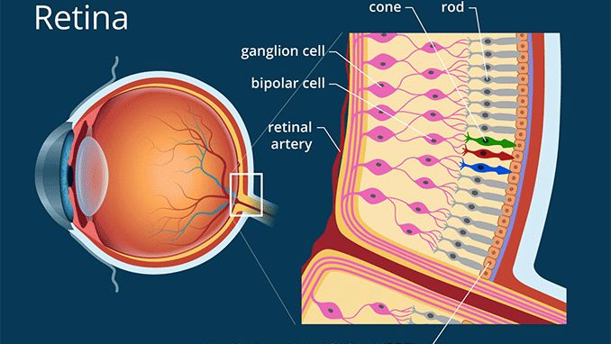

Slide 5
The absence of any of the three types of cones is what
accounts for different types of color blindness.
There are seven official diagnoses of color blindness:
Four different types of color blindness fall in the red-green category.
Two are in the blue-yellow spectrum.
One version describes a type of vision completely lacking in color.

Slide 6
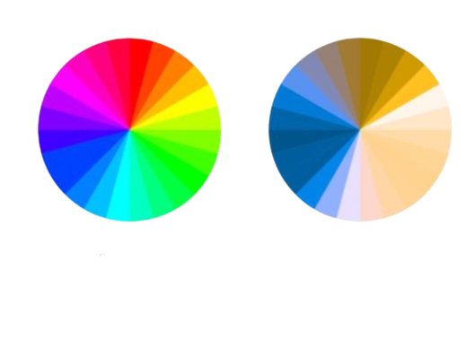
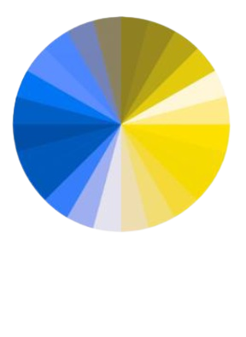
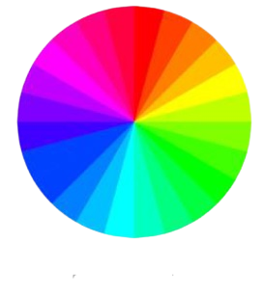
Red-Green color blindness
1)Deuteranopia:(12.5%):
having no green cones. It’s characterized by the inability to distinguish between red and green pigments.
Regular vision Deuteranopia
2) Protanopia:(12.5%):
Individuals have no red cones. make you unable to tell the difference between red and green at all
Regular vision Protanopia

Slide 7

.
3)Deuteranomaly:(62.5%):
Most common type. Individuals have green cones but don’t function properly and can usually see some shades of green.
4)Protanomaly :
Individuals have red cones but don’t function properly and can usually see some shades of red.

Slide 8
Blue-Yellow color blindness
1)Tritanopia:
Individuals have no blue cones. Tritanopia makes you unable to tell the difference between blue and green, purple and red, and yellow and pink. It also makes colors look less bright.
2)Tritanomaly:
Individuals have blue cones and can usually see some shades of blue. Tritanomaly makes it hard to tell the difference between blue and green, and between yellow and red.

Slide 9
Monochromacy (achromatopsia):
Complete color blindness
Monochromacy occurs in only one in every 33,000 people. People with monochromacy see no color at all. For these individuals, the world exists in black and white, much like an old-time television

Slide 10
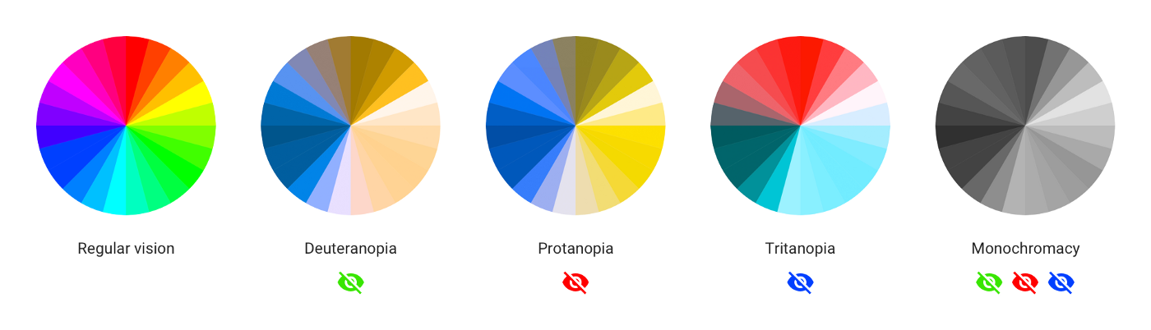

Slide 11
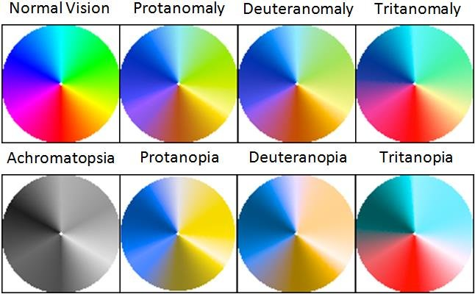

Slide 12
So we created,
The Detector
To be the eyes for those who suffer this disease..

Slide 13
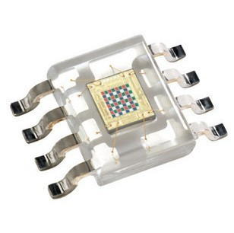
PHOTODIODES : 16 photodiodes with red filter – sensitive to red wavelength 16 photodiodes with green filter – sensitive to green wavelength 16 photodiodes with blue filter – sensitive to blue wavelength 16 photodiodes without filter

Slide 14
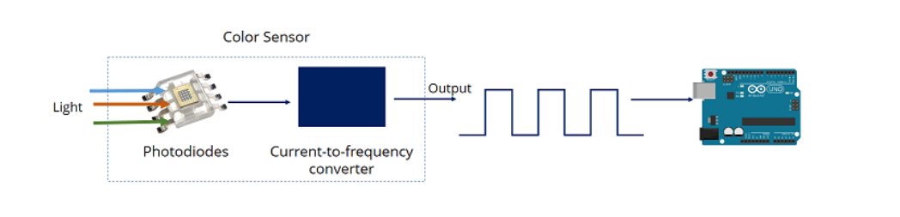
The sensor has a current-to-frequency converter that converts the photodiodes’ readings into a square wave with a frequency that is proportional to the light intensity of the chosen color. This frequency is then, read by the Arduino

Slide 15
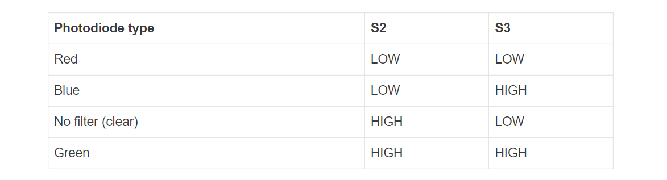
To select the color read by the photodiode, we use the control pins S2 and S3. As the photodiodes are connected in parallel, setting the S2 and S3 LOW and HIGH in different combinations allows us to select different photodiodes

Slide 16
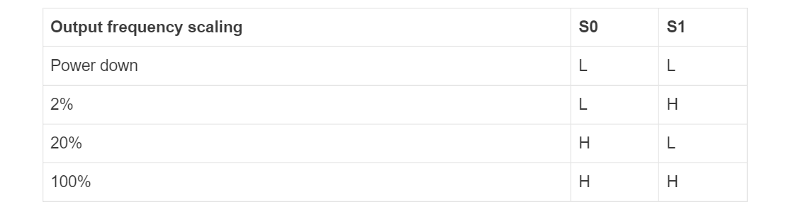
Pins S0 and S1 are used for scaling the output frequency Scaling the output frequency is useful to optimize the sensor readings for various frequency counters or microcontrollers

Slide 17
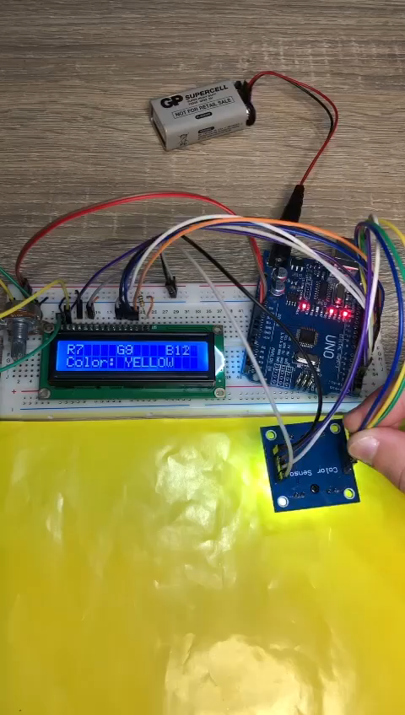

Slide 18
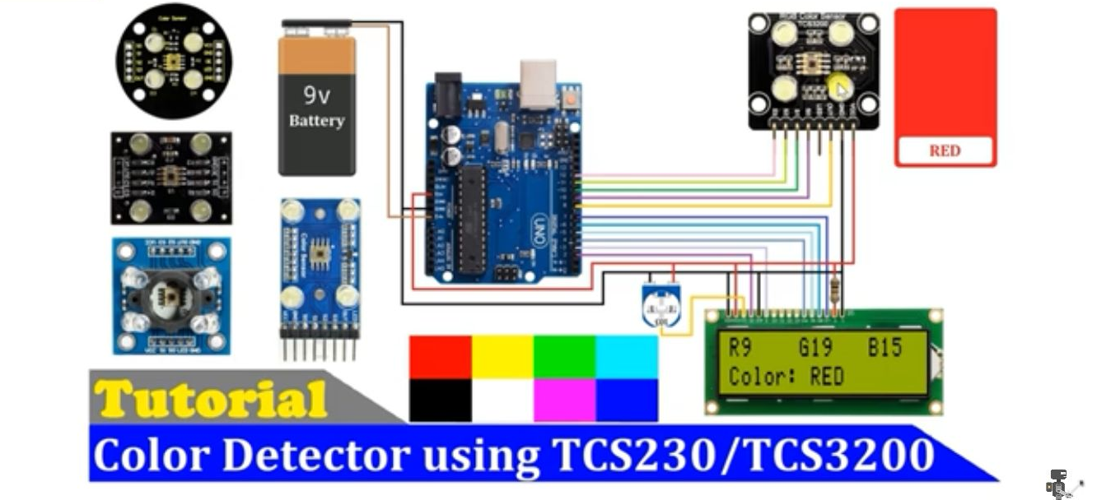

Slide 19
Components Used :
Solderless Breadboard 7. Male to Male Jumper Wires
Arduino Uno 8. Male to Female Jumper Wires
16x2 LCD Display 9. Hard Jumper Wires
TCS3200 color sensor 10. Battery 9v
10k Variable Resistor 11. Battery Clip
100R Resistor

Slide 20
Applications :
In Clothing Shops

Slide 21
Reference:
https://www.allaboutvision.com/conditions/color-blindness/types-of-color-blindness/
https://www.nei.nih.gov/learn-about-eye-health/eye-conditions-and-diseases/color-blindness/types-color-blindness
https://www.healthline.com/health/eye-health/protan-color-blindness#types
https://donatbalipapp.medium.com/colours-maths-90346fb5abda

Slide 22

THANK YOU

